Slide 1
Recursion
Barb Ericson
Georgia Institute of Technology
June 2006

Slide 2
Learning Goals
Understand what recursion means
Understand when to use recursion
Use recursive methods to do things that would be difficult to do with a loop

Slide 3
An example of recursion
Have you ever read the Cat in the Hat Comes Back?
  In it a cat visits two children and messes up the house. When the time come to fix up the house.
    The cat takes off his hat to show another cat (A) and asks that cat (A) to clean up
      That cat takes off his hat to show another cat (B) and asks this cat (B) to clean up
        This goes on and on until the final cat z cleans up the mess using Voom and all the cats go back in the hats

Slide 4
Definition of Recursion
The process a procedure goes through when one of the step of the procedure involves repeating the same procedure
  A method contains a call to the same method
A recursive procedure should have some way to stop
  There is an ending (terminal) condition
It is often used to break a complex problem into a simpler problem of the same type
  Which should eventually lead to the ending condition

Slide 5
Recursive Definitions
Definition of Recursion
  See recursion
    This is the kind of recursion that never stops
Definition of an ancestor
  A person's parents
  And their ancestors (see the definition of ancestor)
  You can list your ancestors by listing your parents and then calling list ancestor on them and so on

Slide 6
Drawing a Tree
A tree has a recursive structure. The trunk of a tree has other branches off of it which in turn have branches off of them, and so on.
If we treat the trunk of the tree like a branch.
  We can draw a tree by telling a turtle to go forward a passed amount (to create the trunk)
  Then hide the current turtle and create two new turtles and turn one left and one right (30 degrees) and tell them to draw a smaller tree
    Call the same method with a smaller branch size
  Stop when the length of the branch gets too small

Slide 7
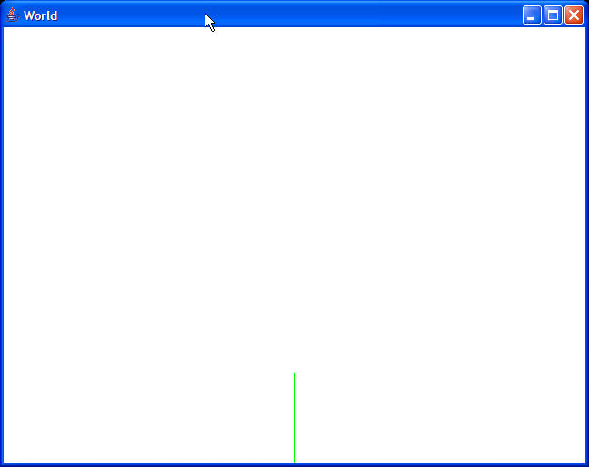
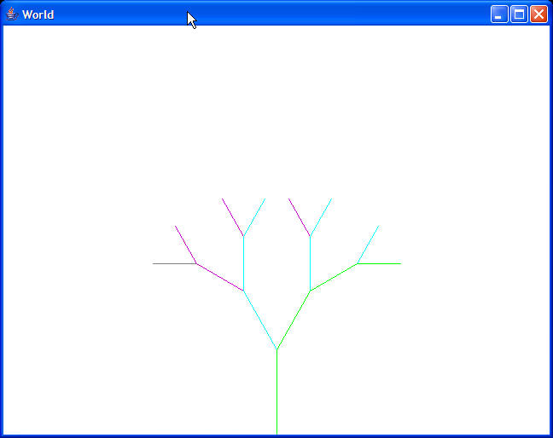
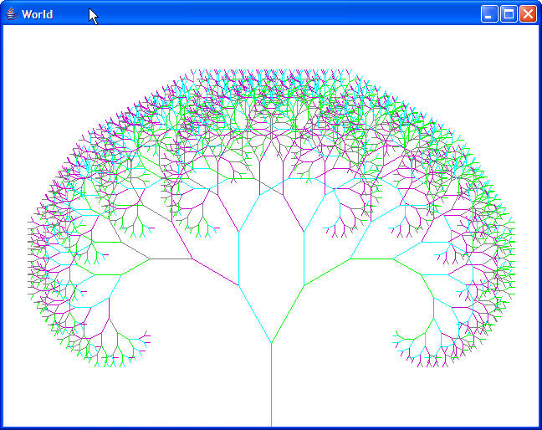
Drawing a Tree with Turtles
After 1 branch is drawn
(the trunk)
After 4 branches
are drawn
Lots of branches
Notes:
This is like an ancestor tree. Each person has 2 parents and they each have two parents and they each have two parents and so on.

Slide 8
Method to Draw a Tree
/**
* Recursive method to draw a tree structure
* @param branchLength the length of the
* current branch
*/
public void drawTree(int branchLength)
{
// only continue if the branch is greater than 5
if (branchLength > 5)
{
// move this turtle forward this.forward(branchLength);
// modify the length of the next branches
branchLength = (int) (0.8 * branchLength);
// get the current turtle values
int x = this.getXPos();
int y = this.getYPos();
ModelDisplay display = this.getModelDisplay();
// create a child to handle the left branch
Turtle leftChild = new Turtle(x,y,display);
leftChild.setHeading(this.getHeading());
leftChild.turn(-30);
leftChild.drawTree(branchLength);
// create a child to handle the right branch
Turtle rightChild = new Turtle(x,y,
this.getModelDisplay());
rightChild.setHeading(this.getHeading());
rightChild.turn(30);
rightChild.drawTree(branchLength);
}
// don't show the turtle
this.setVisible(false);
}

Slide 9
Testing drawTree
public static void main(String[] args)
{
World w = new World();
// don't try to paint while drawing tree
w.setAutoRepaint(false);
Turtle t = new Turtle(320,480,w);
t.drawTree(100);
// now draw the world
w.repaint();
}
Notes:
You need to tell the world to not automatically repaint when the turtles move so that we don't have too many turtles all trying to draw at the same time. Instead when we are done creating the drawing we redraw the world.

Slide 10
How This Works
t.drawTree(100); will invoke the drawTree method
  The Turtle t will move forward 100 and then change the branch length to 80. Then it creates a new left child and turns it left 30 degrees
    Then it invokes leftChild.drawTree(80);
      Moves forward 80 and then creates a new leftChild
        leftChild.drawTree(64);
        And so on till the length of the branch is <= 5
Then execution will continue after the last call to leftChild.drawTree which will create the right child

Slide 11
The Call Stack
The computer keeps track of each method it executes including where the method was invoked from, the parameters, and the local variables
  main 303 parameter of 100
    drawTree 181 parameter of 80
      drawTree 181 parameter of 64
        drawTree 181 parameter of 51 …
Each time a new method is called it is added to the top of the call stack (shown at the bottom here)
When a called method is finished the top of the call stack is removed and execution continues at the statement following the call to the method

Slide 12
Recursive Triangles
If you have a triangle you can break it into 4 new triangles
  Create a point at the mid point of each side and connect them with line segments
  Now you can break up the resulting 4 triangles

Slide 13
Create a Triangle Class
Each triangle can be defined by 3 points
  You can use the Point class in java.
Write a method to subdivide the current triangle
  Create 3 new points and 4 new triangles
  You can call the method on the new triangles
p1
p1
p4
p5
p2
p3
p2
p3
p6

Slide 14
Triangle Class
import java.awt.*;
/**
* Class that represents a triangle
* @author Barb Ericson
*/
public class Triangle
{
//////////// fields /////////////
private Point p1;
private Point p2;
private Point p3;
///////////// constructors /////////
/**
* Constructor that takes 3 points
* @param pt1 the first point
* @param pt2 the second point
* @param pt3 the third point
*/
public Triangle(Point pt1, Point pt2, Point pt3)
{
p1 = pt1;
p2 = pt2;
p3 = pt3;
}
/////////////// methods ///////////////
/**
* Method to find the midpoint between two points
* @param pt1 the first point
* @param pt2 the second point
* @return the point in the middle of the
* two points
*/
public static Point getMidpoint(Point pt1,
Point pt2)
{
double x = Math.abs(pt1.x - pt2.x) * 0.5 +
Math.min(pt1.x,pt2.x);
double y = Math.abs(pt1.y - pt2.y) * 0.5 +
Math.min(pt1.y,pt2.y);
Point pt = new Point((int) x,(int) y);
return pt;
}

Slide 15
Triangle Class - Continued
/**
* Method to get the length between the two points
* @param pt1 the first point
* @param pt2 the second point
* @return the distance between the points
*/
public static double getDistance(Point pt1, Point pt2)
{
double diffX = pt1.x - pt2.x;
double diffY = pt1.y - pt2.y;
double dist = Math.sqrt((diffX * diffX) +
(diffY * diffY));
return dist;
}
/**
* Method to get the length of the smallest side
* @returns the length of the smallest side
*/
private double getSmallestLength()
{
double dist1 = getDistance(this.p1,this.p2);
double dist2 = getDistance(this.p2,this.p3);
double dist3 = getDistance(this.p3,this.p1);
double smallest = Math.min(dist1,dist2);
smallest = Math.min(smallest,dist3);
return smallest;
}

Slide 16
Triangle Class - Continued
/**
* Method to recursively subdivide the triangle
* @param g the graphics context to draw in
* @param smallestLength the smallest allowed length
*/
public void subdivideTriangle(Graphics g,
int smallestLength)
{
double currSmallest = this.getSmallestLength();
if (currSmallest > smallestLength)
{
Point pt12 = this.getMidpoint(p1,p2);
Point pt23 = this.getMidpoint(p2,p3);
Point pt31 = this.getMidpoint(p1,p3);
g.drawLine(pt12.x,pt12.y,pt23.x,pt23.y);
g.drawLine(pt23.x,pt23.y,pt31.x,pt31.y);
g.drawLine(pt12.x,pt12.y,pt31.x,pt31.y);
Triangle t1 = new Triangle(this.p1,pt31,pt12);
Triangle t2 = new Triangle(this.p2,pt12,pt23);
Triangle t3 = new Triangle(this.p3,pt31,pt23);
Triangle t4 = new Triangle(pt12,pt23,pt31);
t1.subdivideTriangle(g,smallestLength);
t2.subdivideTriangle(g,smallestLength);
t3.subdivideTriangle(g,smallestLength);
t4.subdivideTriangle(g,smallestLength);
}
}
}

Slide 17
Draw Triangles Method
public static Picture drawTriangles(int smallestLength)
{
Picture pict = new Picture(100,100);
Point p1 = new Point(50,0);
Point p2 = new Point(0,100);
Point p3 = new Point(100,100);
Triangle t1 = new Triangle(p1,p2,p3);
Graphics g = pict.getGraphics();
g.setColor(Color.BLACK);
g.drawLine(p1.x,p1.y,p2.x,p2.y);
g.drawLine(p2.x,p2.y,p3.x,p3.y);
g.drawLine(p3.x,p3.y,p1.x,p1.y);
t1.subdivideTriangle(g,smallestLength);
return pict;
}
Notes:
You can add this to the Picture class to draw recursive triangles. It creates a picture and draws on it.

Slide 18
Applications of Recursion
In 3D graphics we break up a sphere into triangles to display
  If the sphere is small on the display you don't need many triangles
  If the sphere is bigger on the display you need more triangles
  Use recursion to get the right amount of triangles based on the displayed size

Slide 19
Processing Files
A directory can have other directories
  So you can use a recursive method to list all the files in each directory
  Or to create an HTML page with thumbnails of all of the pictures in a directory
  You can use the java.io.File class to represent a directory
    And to find all of the files in a directory including other directories
      Use listFiles() to get an array of File objects
      Use isDirectory() to check if a file is a directory

Slide 20
Exercise
Open class DirectoryWorker
Create a static method listFiles that creates a java.io.File object for a given directory
  List all of the files in that directory
    File[] fileArray = listFiles()
  For each file in the directory that is also a directory list the files in that directory
    file.isDirectory()

Slide 21
Summary
Recursion features a method that calls itself
  With some way to end the recursion
It is used on data structures that are recursive
  Like trees
It can also be used for methods that have a recursive definition
  Like fibonacci numbers
  http://www.mcs.surrey.ac.uk/Personal/R.Knott/Fibonacci/fibnat.html
  Fibonacci of 0 is 0 and of 1 is 1 and of n is Fib(n-1) + Fib(n-2)

